Slide 1

Rockbuster Stealth: Data Analysis
By: Ava Kramer

Slide 2
Introduction
Rockbuster Stealth LLC is a movie rental company that used to have stores around the world. Facing stiff competition from streaming services such as Netflix and Amazon Prime, the Rockbuster Stealth management team is planning to use its existing movie licenses to launch an online video rental service in order to stay competitive.

Slide 3
Key Questions
Which movies contributed the most/least to revenue gain?
What was the average rental duration for all videos?
Which countries are Rockbuster customers based in?
Where are customers with a high lifetime value based?
Do sales figures vary between geographic regions?

Slide 4
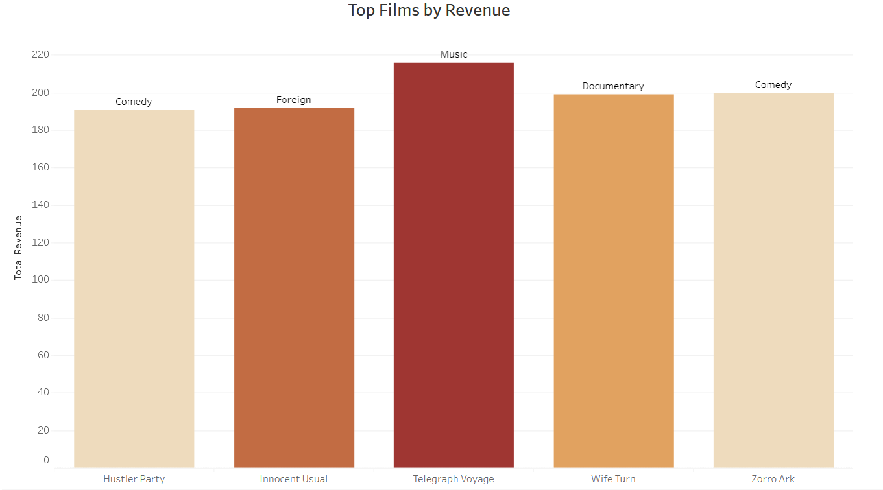
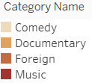
Which genres had the highest revenue gain?
The films that contributed the most to revenue gains were as follows: Hustler Party, Innocent Usual, Telegraph Voyage, Wife Turn, and Zorro Ark.
The genres that these films fell into were comedy (2 films), documentary, foreign, and music.

Slide 5
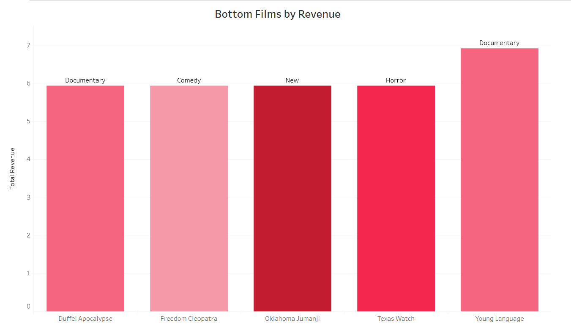
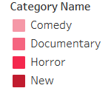
Which genres contributed least to revenue gain?
The films following films contributed least to revenue gains were as follows: Duffel Apocalypse, Freedom Cleopatra, Oklahoma Jumanji, Texas Watch, and Young Language.
The genres that these films fell into were comedy, documentary (2 films), horror, and new.

Slide 6
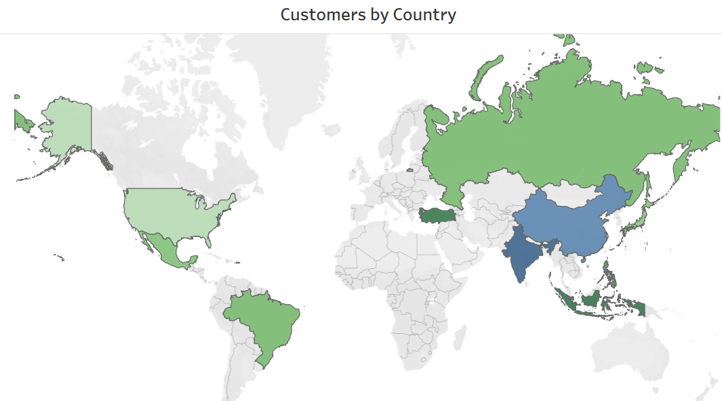
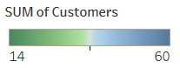
Which countries are Rockbuster customers based in?
The top 10 countries are shown on the map to the left.
India and China led the group by a significant margin while Turkey and Indonesia fell at the bottom.

Slide 7
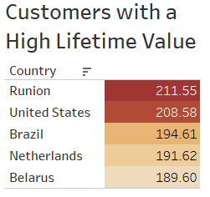
Where are customers with a high lifetime value based?
The customers with the highest lifetime values were in the countries are shown in the list to the right in descending order.
Runion had the highest contributing customer while Belarus had the lowest.
We can investigate why this may be, and determine if there are any patterns in geographic location of high lifetime value customers.
Notes:
What are we doing with this information? Why is it important?

Slide 8
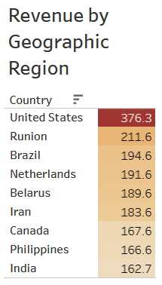
Do sales figures vary between geographic regions?
The top 10 countries contributing to revenue are shown on the right in descending order.
The United States is at the top of the list while India comes in at the tenth spot.
This list shows us where the most demand is for streaming platforms and therefore which areas produce the most revenue as well as which regions could use some improvement.
Notes:
Specifically mention that they vary. Why is it important? Why are we looking at that?

Slide 9
Recommendations
Make regions with the highest customer count a priority (India, China, United States). Advertise in these areas to increase both customer count and revenue gain. For example, Rockbuster could offer promotions to people who refer new customers.
It would also be a good idea to investigate the differences in geographic regions to see why some countries have more customers than others. Knowing the reasons could impact the advertising strategy.
Regions with a small customer count could also have increased advertising to raise awareness of the streaming service. There is a possibility people may not be aware of it since it is new.

Slide 10
URL of Visualization in Tableau Public
https://public.tableau.com/app/profile/ava.kramer/viz/TopFilmsbyRevenue/Sheet1?publish=yes
https://public.tableau.com/app/profile/ava.kramer/viz/BottomFilmsbyRevenue/Sheet1
https://public.tableau.com/app/profile/ava.kramer/viz/CustomersbyCountry_16848641094370/Sheet1
https://public.tableau.com/app/profile/ava.kramer/viz/CustomerswithHighLifetimeValue/Sheet1?publish=yes
https://public.tableau.com/app/profile/ava.kramer/viz/RevenuebyGeographicRegion/Sheet1?publish=yes
Notes:
Before this slide, add a conclusion/final recommendation slide. Put links in order.

